Slide 1



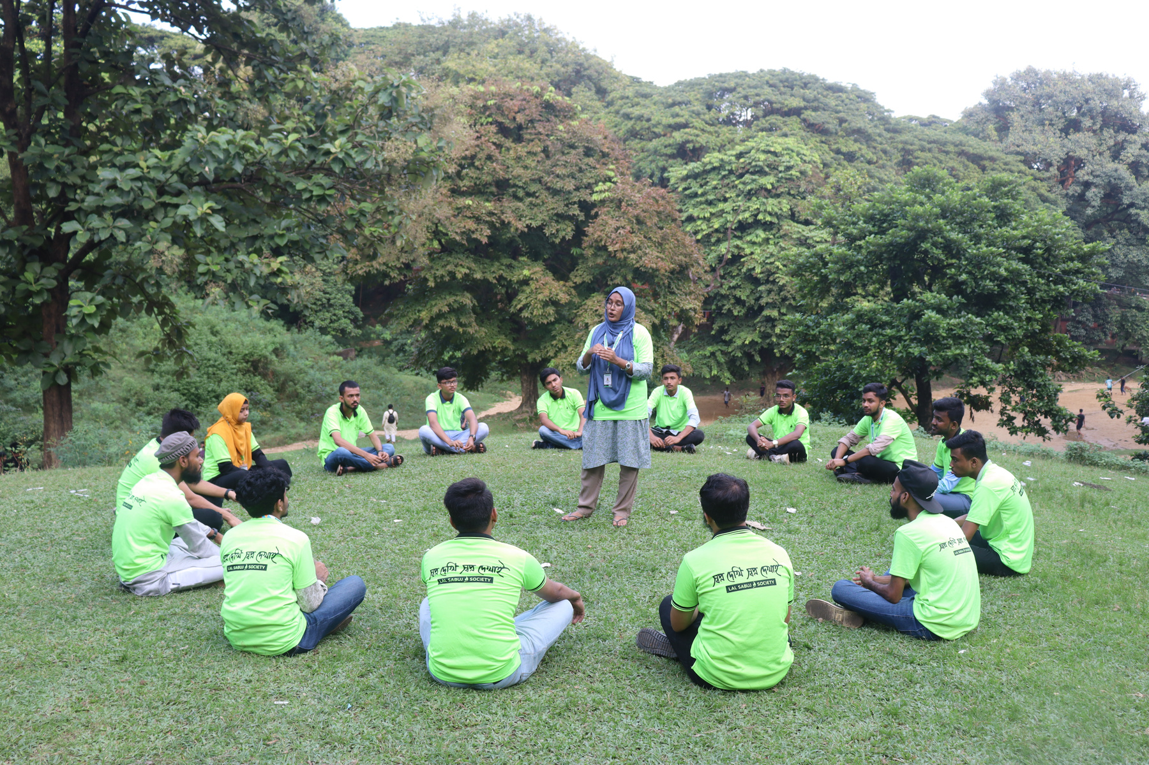

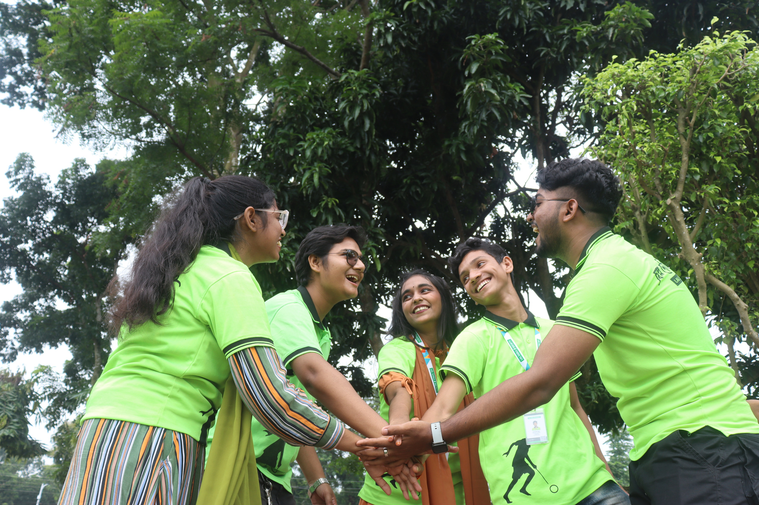
ENGAGING YOUTH FOR
Positive Change

Slide 2
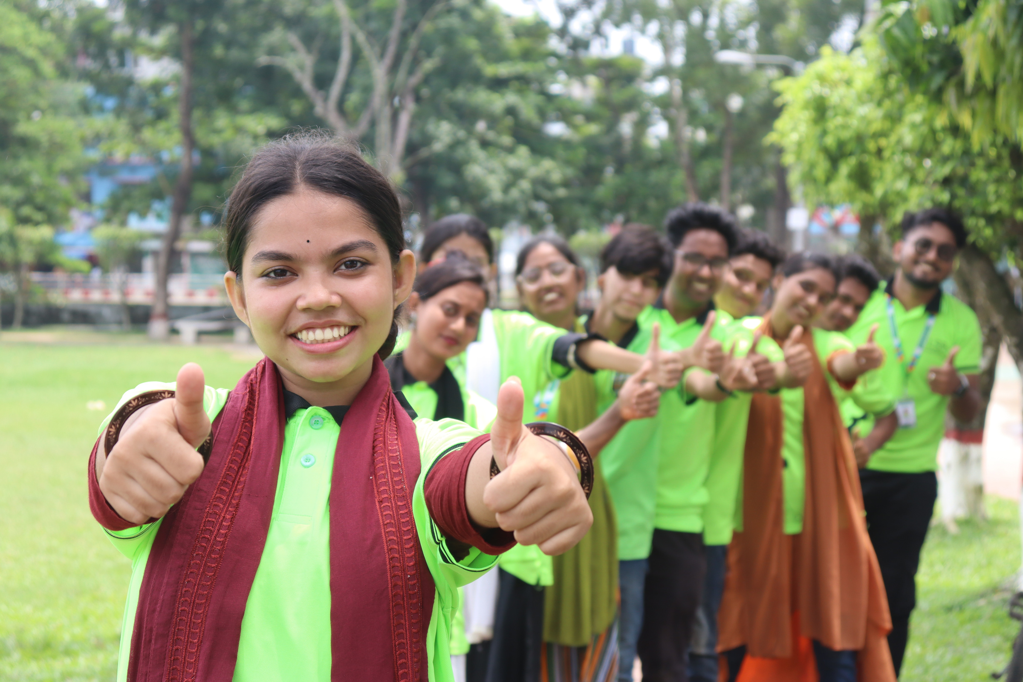

WHO WE ARE
Lal Sabuj Society (LSS) is a youth-led non-profit organization empowering young leaders through education, volunteerism, and advocacy to tackle global challenges.
Reach: Over 1,78,478 People
Key Sectors: Climate Action, Mental Health, Protection, Skill Development, Media Action, Humanitarian Action and Emrgency Response.

Slide 3


Lal Sabuj Society (LSS) started in May 2010 in Barisal as a small youth group. Today, it has grown into a national movement that helps young people tackle social issues.
OUR JOURNEY
Launch
Formation
Certification
Launched The Monthly
Lal Sabuj as a children’s magazine in Barisal.
Established Lal Sabuj Foundation as a youth-led organization.
Received registration from the Youth Development Department.
2010
2015
2022
May
DEC
April
2013
2019
2024
May
March
Oct
Engagement
Recognition
Outreach
Organized a dialogue session between children and mayoral candidates during the city mayor election.
Officially registered as Lal Sabuj Society under the Social Welfare Department.
Reached 147,000 individuals through various initiatives.

Slide 4
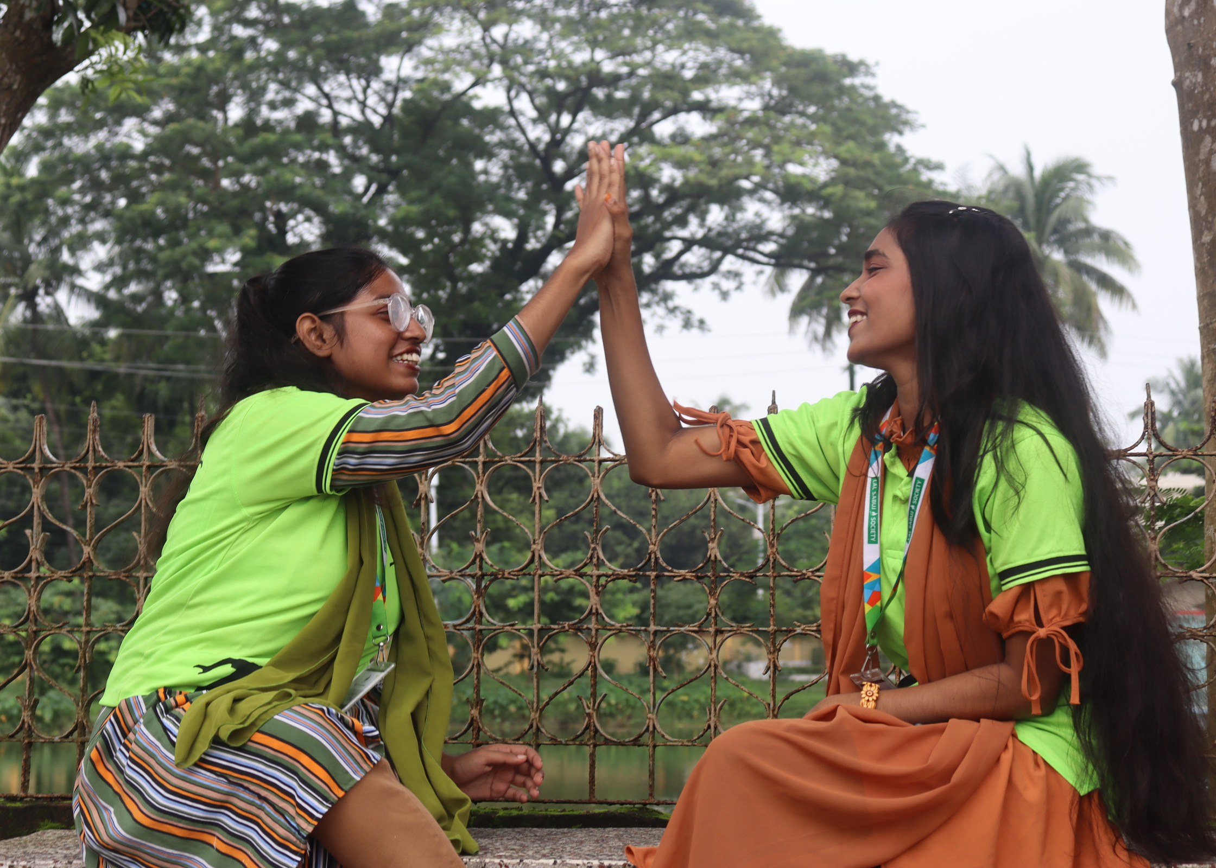
VISION & MISSION
- Our Mission
To engage and empower youth in voluntary work and promote positive social change in Bangladesh.
- Our Vision
To build a society where youth are active citizens and leaders in creating a sustainable future.

Slide 5
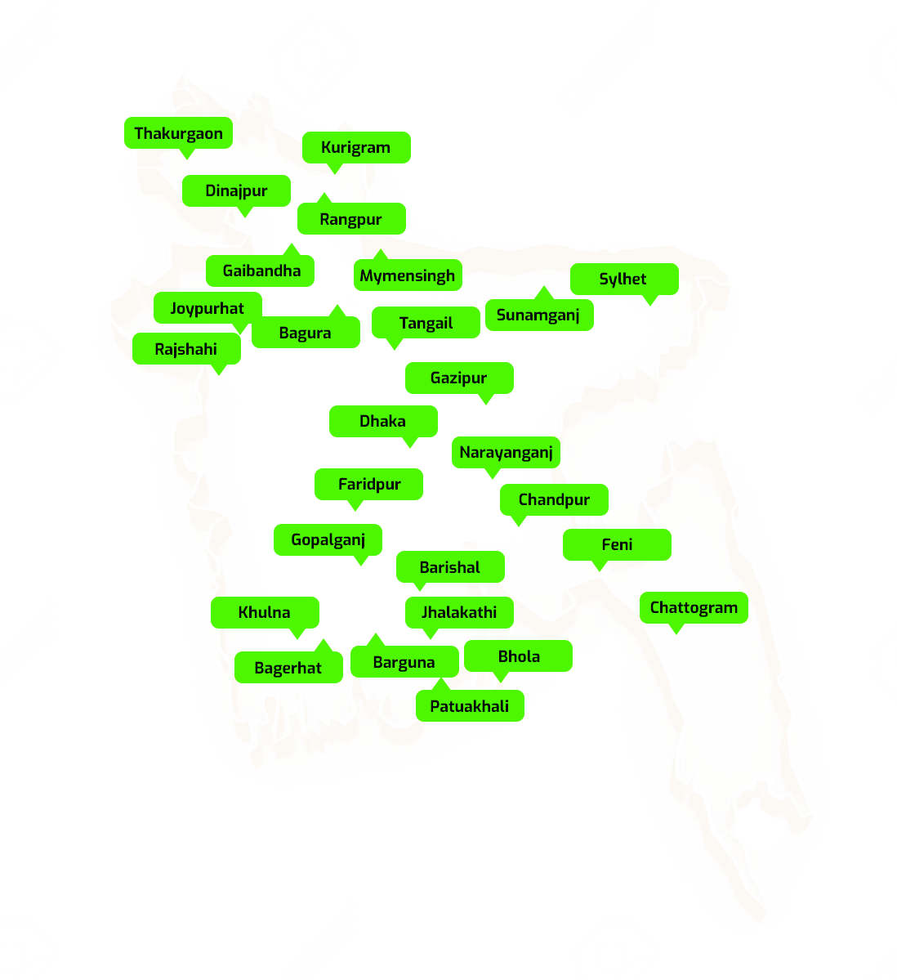
WHERE WE WORK
32
Districts
Lal Sabuj Society (LSS) operates across Bangladesh, with an active presence in multiple districts and regions. Our work spans both urban and rural areas, reaching diverse communities through our various programs and initiatives.

Slide 6







OUR CONTRIBUTION TO SDGS
3.4
3.6
4.4
4.7
5.1
5.2
5.3
6.1
6.2
6.4
8.3
8.5
8.6
13.1
13.2
13.3
16.1
16.2
16.5
5.4
5.5
5.C
6.6
6.A
6.B
8.9
16.9
16.10

Slide 7
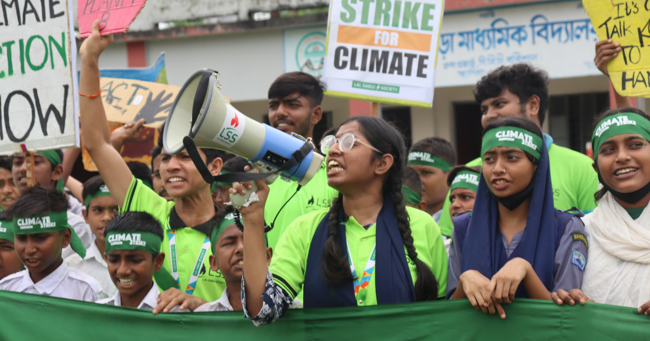
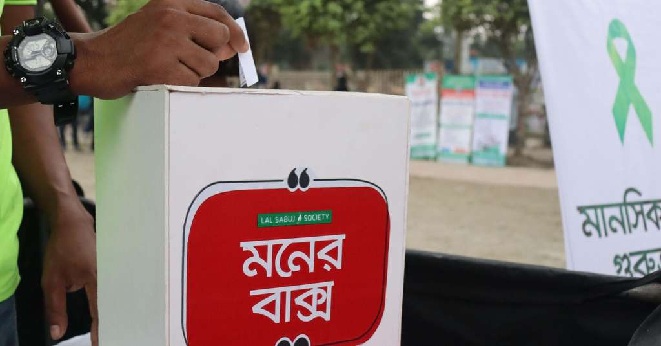
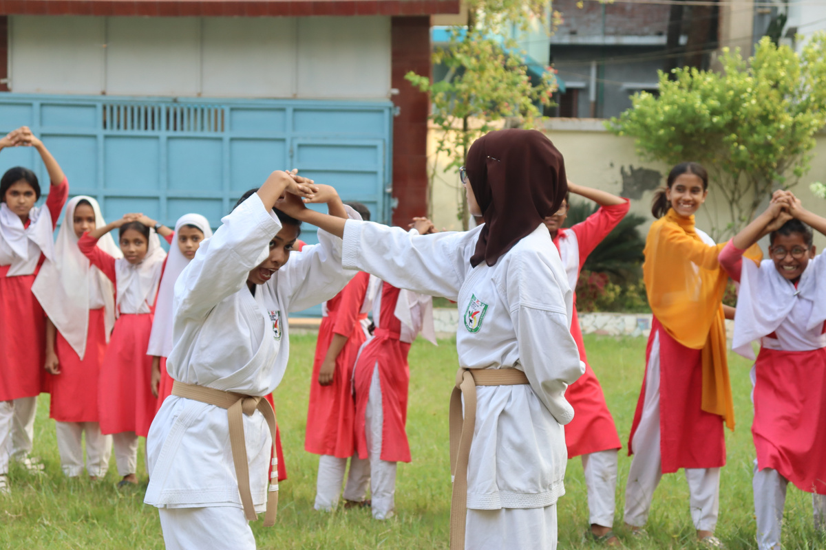

OUR FOCUS AREAS
Climate Action
Mental Health
Protection
Empowering youth in Bangladesh through climate action, education, and sustainability initiatives.
Promoting mental well-being, support, and awareness across communities.
Ensuring the safety and rights of vulnerable communities.

Slide 8
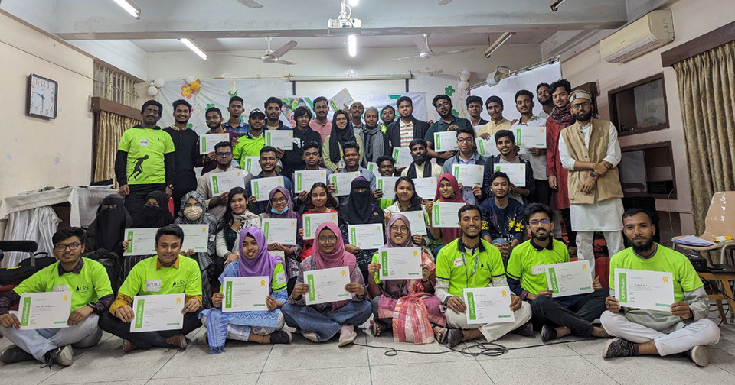
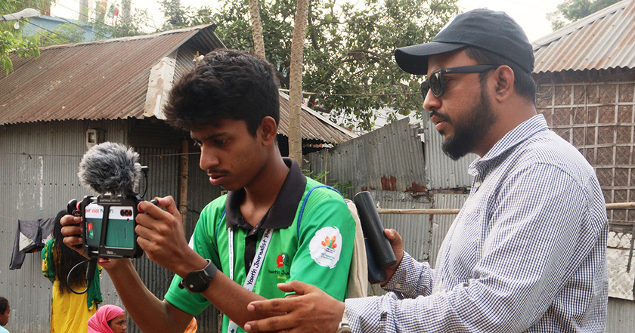
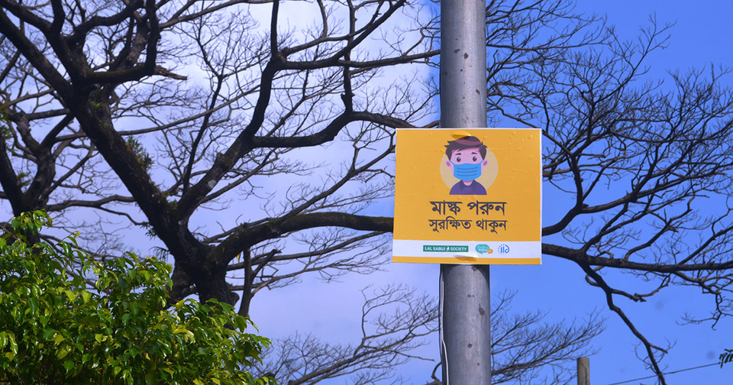
OUR FOCUS AREAS
Skill Development
Media Action
Emargency Response
Providing youth with skills for personal growth and success.
Empowering youth through responsible journalism and civic engagement to drive positive change in society.
Dedicated to serving our nation in times of crisis through swift and effective emergency response.

Slide 9

ALL PROJECTS

Slide 10
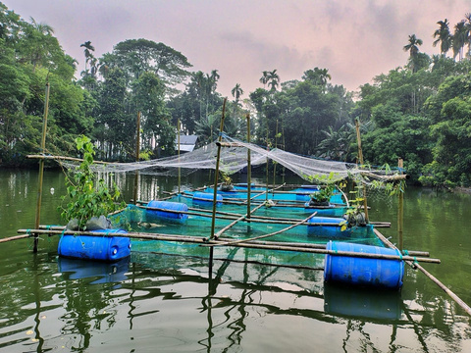
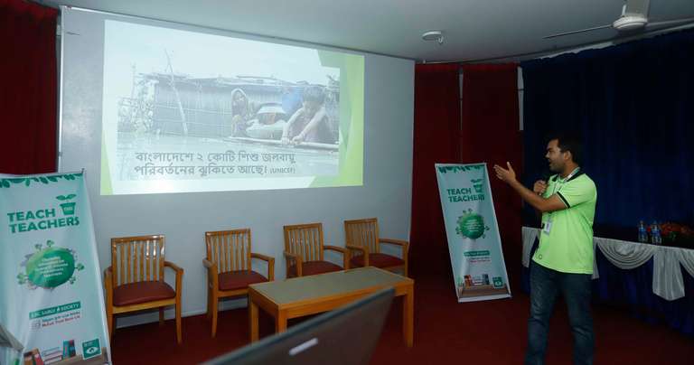
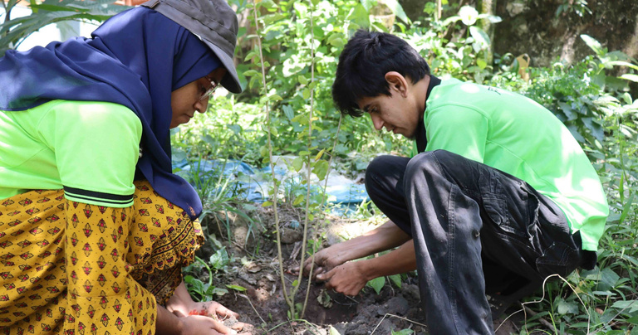
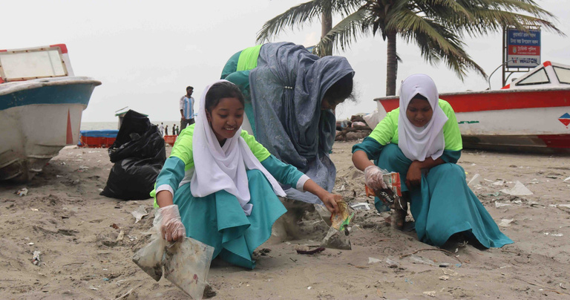
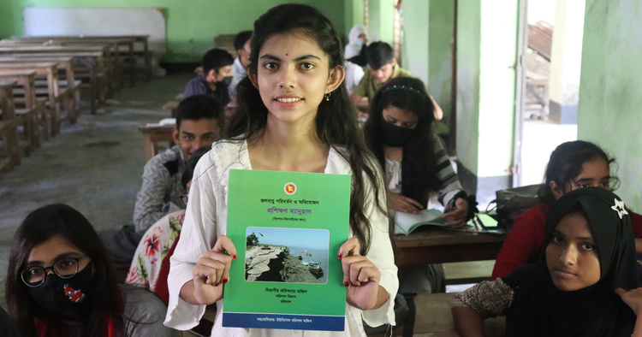
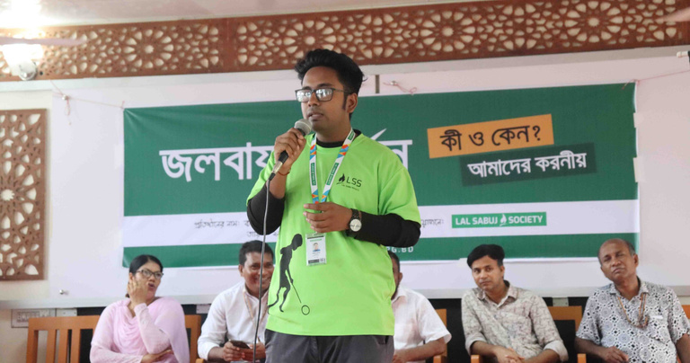
CLIMATE ACTION
Local Led Adaption
Tech the Teacher
Tree Plantation Drives
Cleanup Awareness and Campaign
Youth in Climate Action Workshop
Climate Change School Session

Slide 11
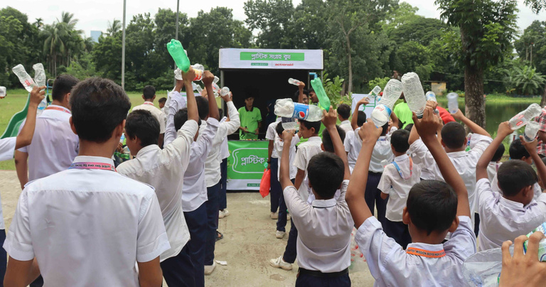
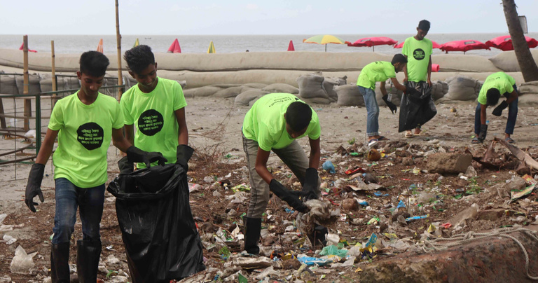
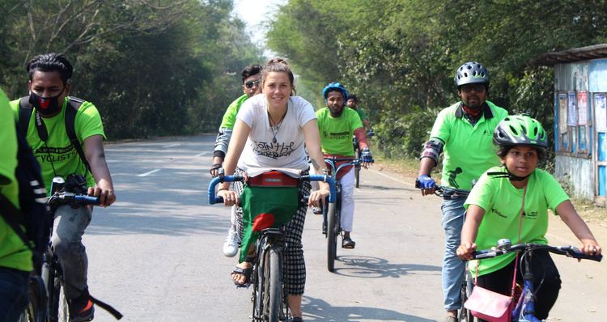
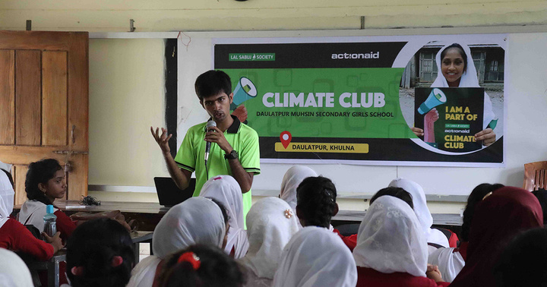
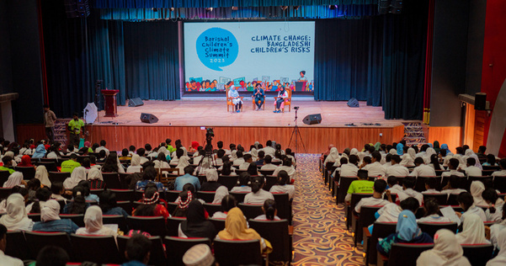
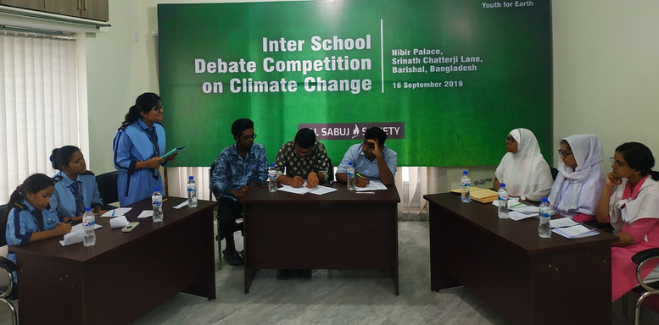
CLIMATE ACTION
Plastic Market
Eco-friendly Tourism
Promoting Cycling
Climate Club
Children's Climate Summit
Climate Debate Championship

Slide 12
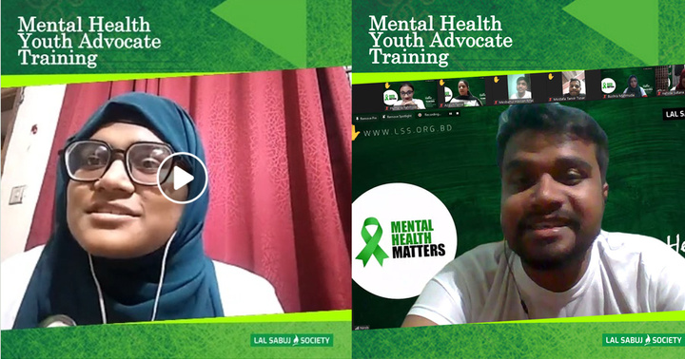
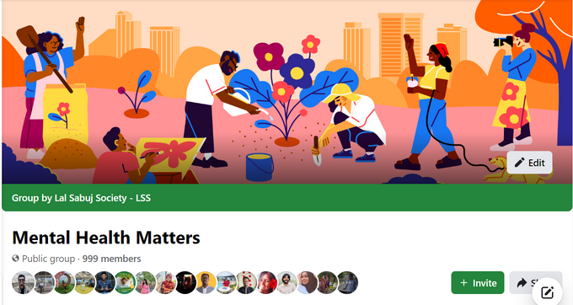
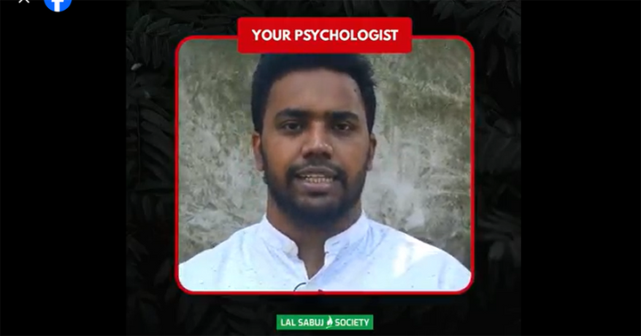
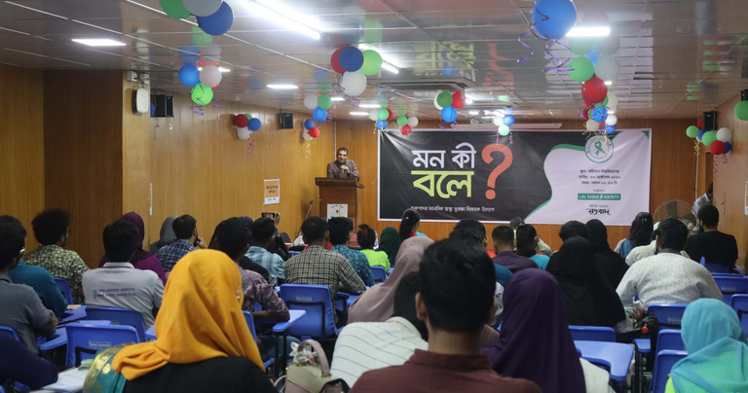
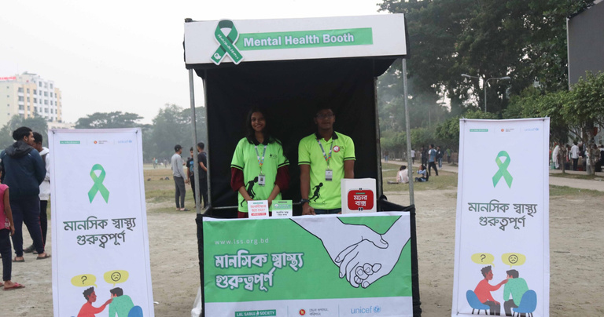
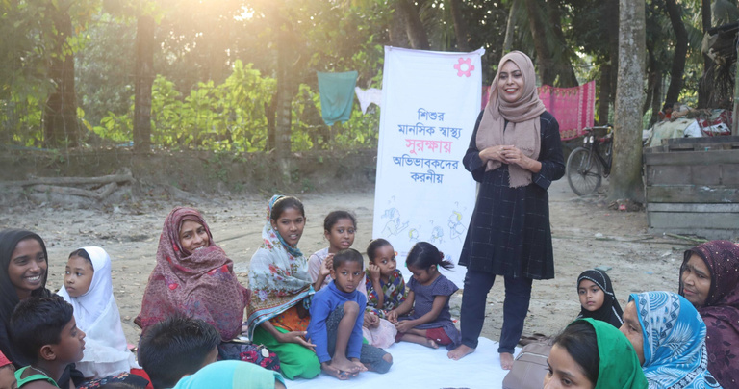
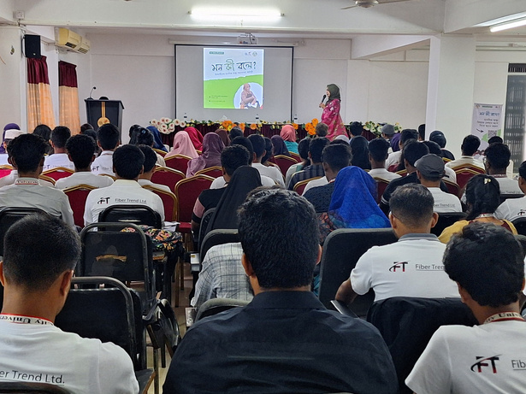
MENTAL HEALTH
Mental Health Youth Advocate
Mental Health Matters
Your Phycologist
Mon ki Bole?
Mental Health Awareness Booth
Community Mental Health Awareness
All kind of Mental Health Service

Slide 13
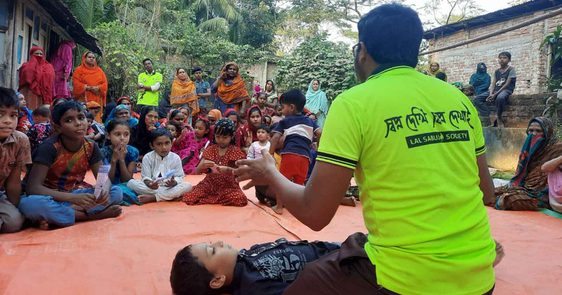
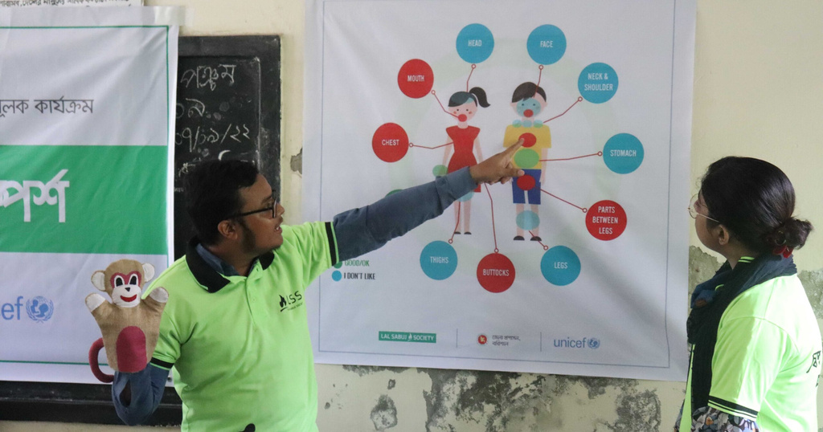
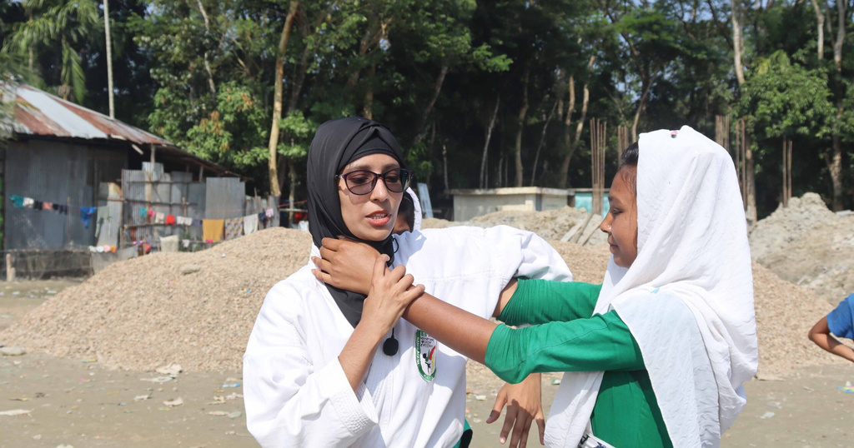
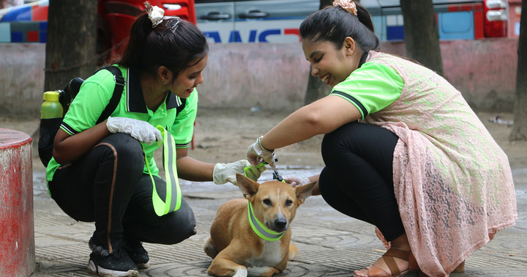
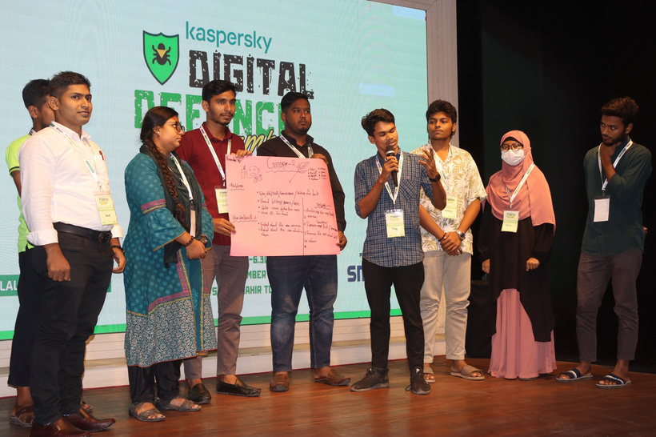
PROTECTION
Prevent Child Drowning
Good & Bad Touch Session
Self Defense for Girls
Project Dog belt
Internet and Device Safety

Slide 14
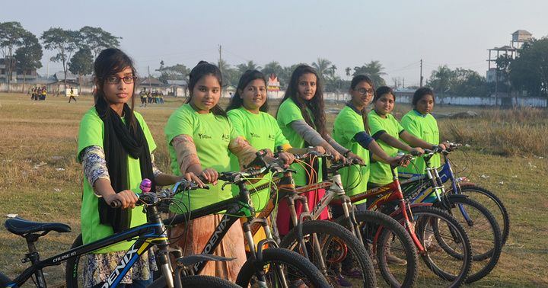
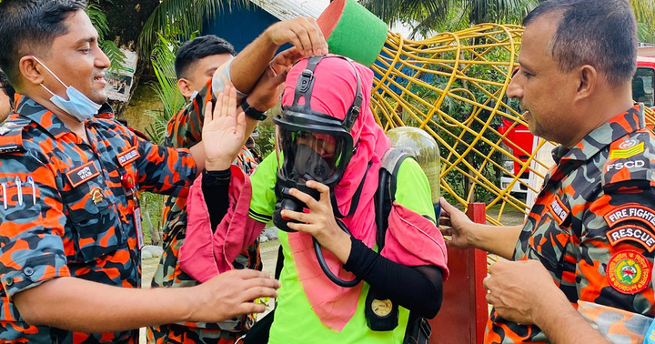
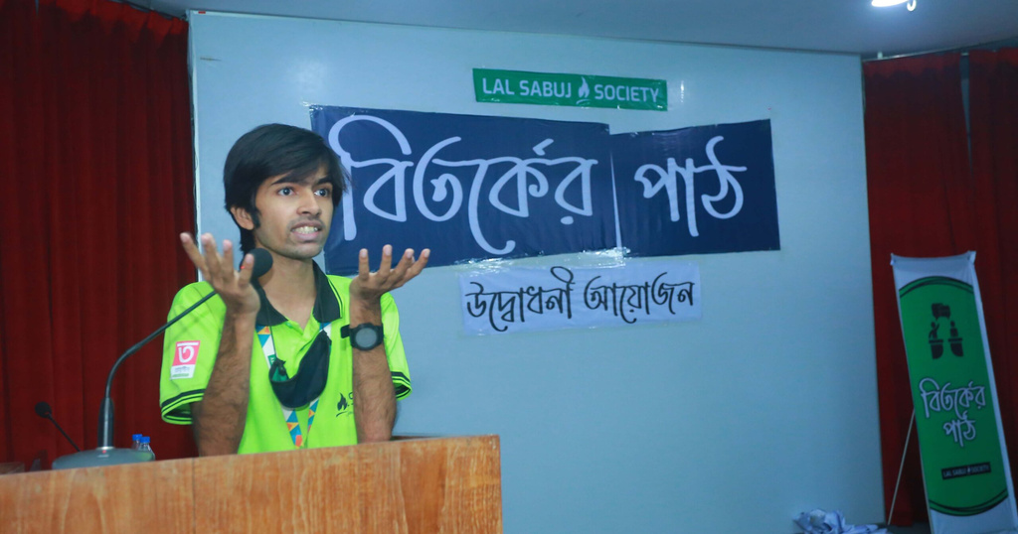

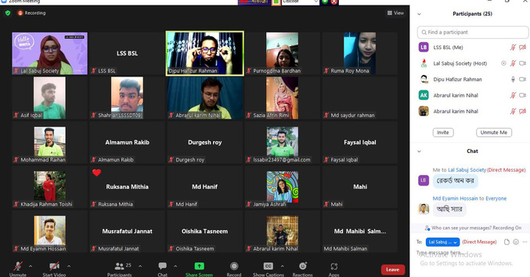
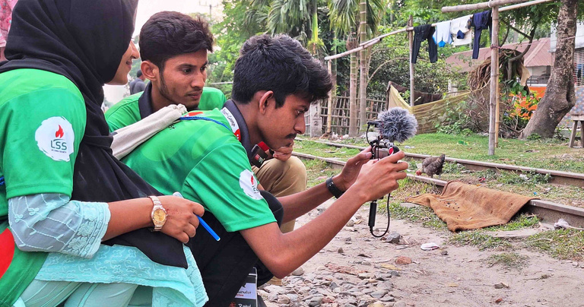
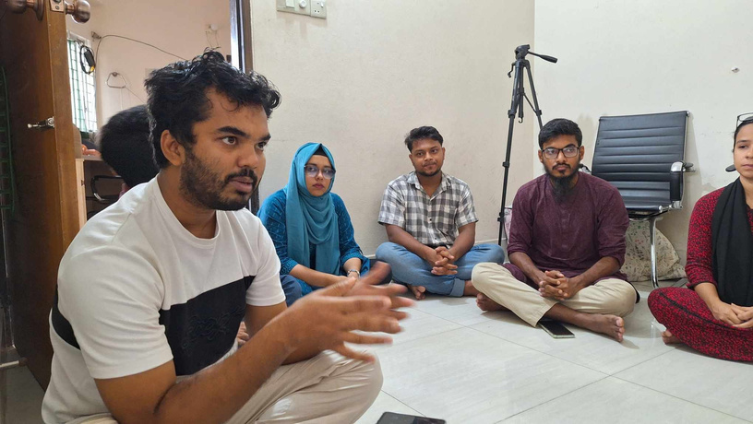
SKILL DEVELOPMENT
Cycling for Girls
Fire Safety Training
Bitorker Path
Learn to Lead
CV Writing Workshop
Soft Skill Training
Career Guideline Session

Slide 15
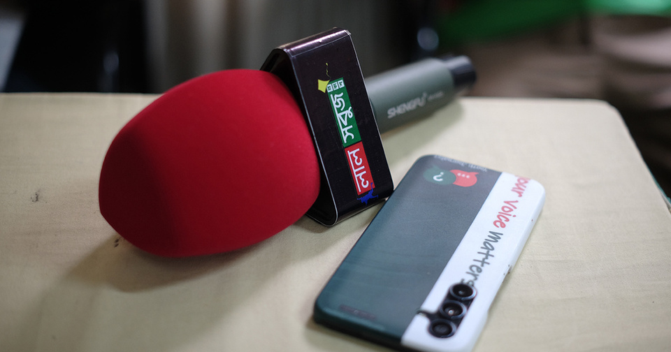
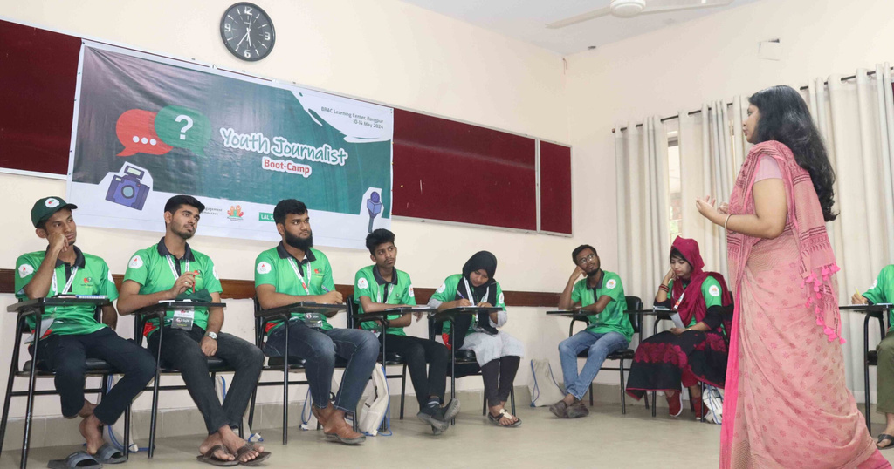
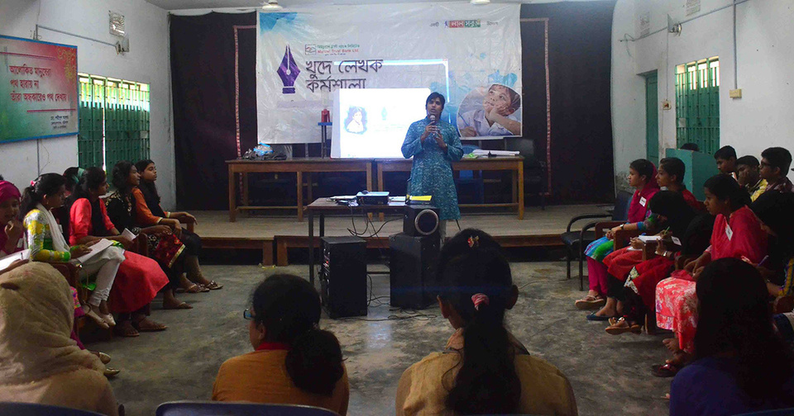
MEDIA ACTION
Lal Sabuj Prokash
Youth Journalist Training
Khude Lekhok kormoshala

Slide 16
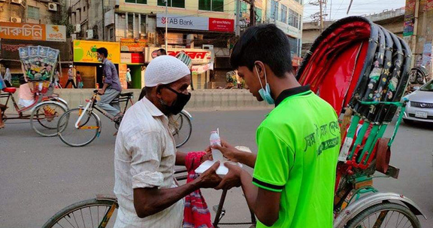
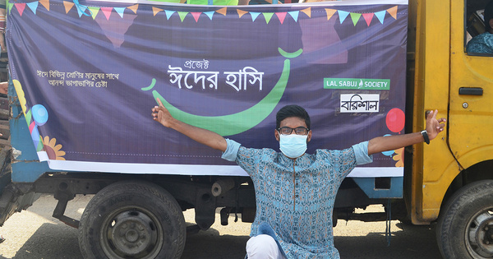
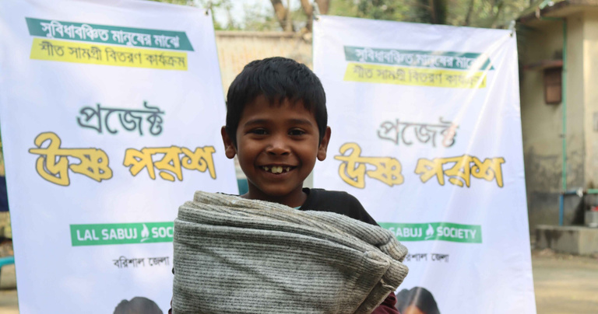
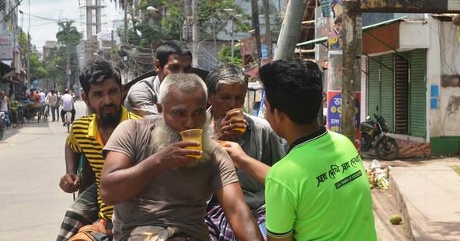
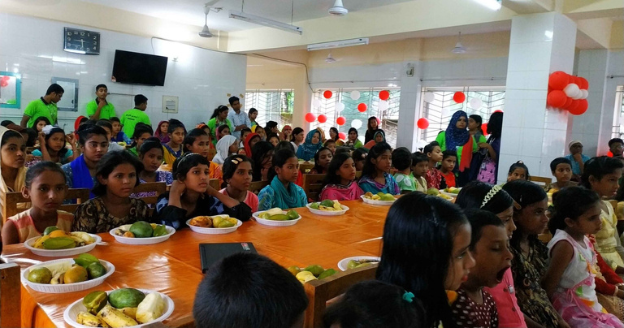
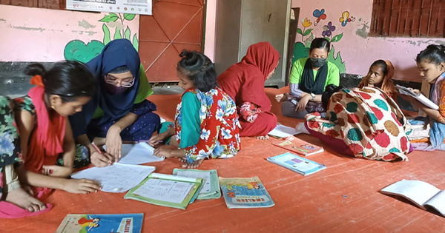




HUMANITARIAN INITIATIVE
Shobar jonno Iftar
Project Eider Hashi
Project Ushno Porosh
Project Trishna Metai
Fol Utsab
Sabuj Pathshala
Pitha Utshab
Umbrella Cap Distribution
Educational Materials Distribution
Mehedi Utshab

Slide 17




EMARGENCY RESPONSE
Digester Response
Covid Response
Dengue Awareness
Traffic Control
Social Awareness

Slide 18
ORGANIZATIONAL STRUCTURE
National Executive Board
Advisory Penel
President
Vice President
General Secretary
Joint General Secretary
Treasurer
Executive Member
Executive Member
National Management Team
HR/Admin
Communication
Social Media
Volunteer Coordinator
Research
Training
Accounts
Program
Logistics
Team
Team
Team
Team
Team
Team
Team
Team
Team
District Committee
President
Vice President
General Secretary
Joint General Secretary
Treasurer
Executive Member
Executive Member
Volunteer

Slide 19

OUR POLICIES &
WORKFORCE
Policies: Gender, Safeguarding, HR, Finance,
Code of Conduct, Office Environment Protocol.
Volunteer:
2500+
Stuff:
18

Slide 20













OUR PARTNERS

Slide 21


STORIES OF IMPACT
Local Led Adaptation
Project Aparajita
Master Amir Hossain, a retired headmaster in Mehendiganj, once saw floods as a threat to fish farming. However, with Lal Sabuj Society's agroecological project, his unused pond was transformed. Floating structures allowed fish farming and vegetable cultivation to thrive, even during floods. "I never thought we could cultivate so much in floodwater," Amir said. Now, he inspires others to embrace these innovative practices, turning floods into an opportunity for sustainable farming in his community.
Sajia Afrin Raka, a passionate karate practitioner, began her journey in 2019 through Lal Sabuj Society's Aparajita project, initially as a student in a three-day course. Despite social and family opposition questioning why a girl should learn karate, she persevered and eventually gained her family’s support. Today, Raka is a black belt (1st Dan) and serves as a trainer for Aparajita, empowering other young girls through karate.

Slide 22







OUR PRESENCE IN MEDIA

Slide 23





LET’S CONNECT
+88 01771184743
WWW.LSS.ORG.BD
LALSABUJSOCIETYBD@GMAIL.COM
6A, MOMTAJ NOOR VILLA, HOUSE 46,
5TH FLOOR, SHEWRAPARA, DHAKA

Slide 24

THANK YOU

